Slide 1
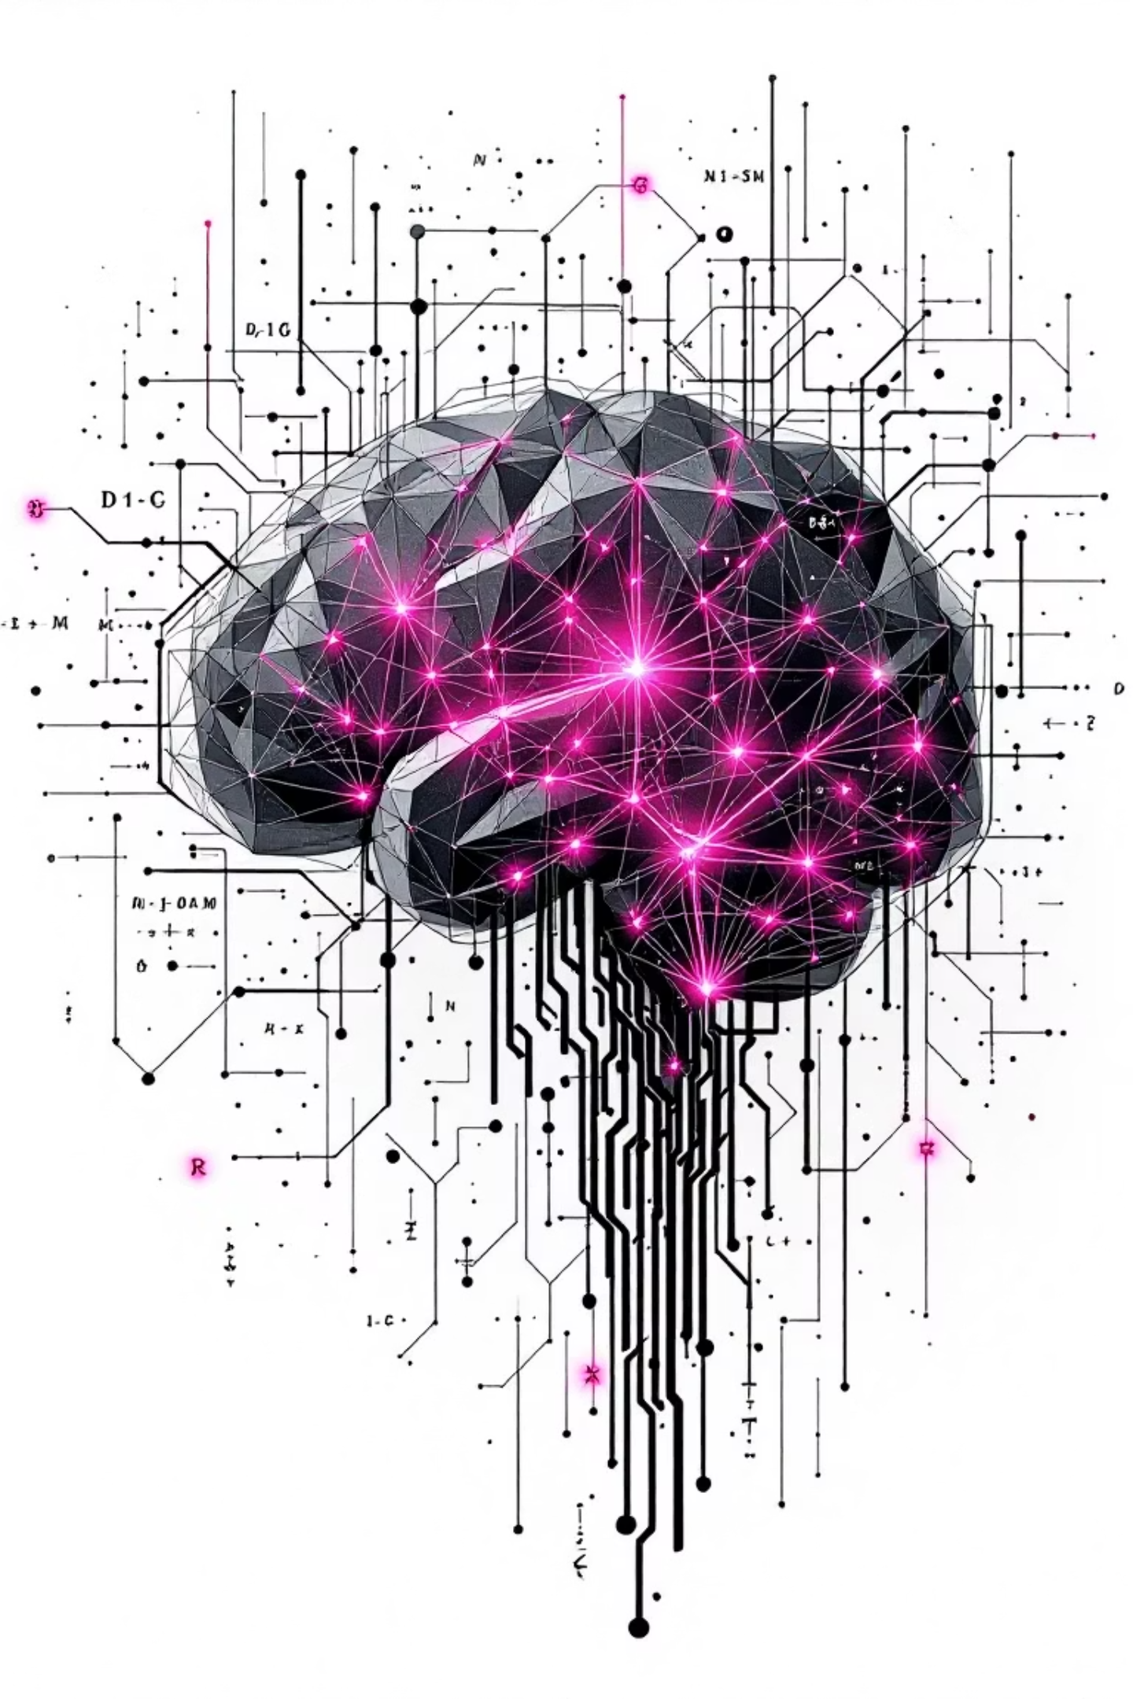

Machine Learning: An Introduction
Prasanna Ranjith Christodoss
Associate Professor of Computer Science
Department of Computing, Mathematics & Physics
Messiah University
Mechanicsburg, PA 17055
T 717-796-1800 | Ext 2739
E prchristodoss@messiah.edu | W messiah.edu
CIS418 – Machine Learning – Prasanna Christodoss, Associate Professor, Messiah University, PA. Source: Machine Learning using Python – By Mark Fenner, Pearson Ed. Pub. & Other online data

Slide 2
Traditional Programming
Program
Input
Output
Human Created

Slide 3
Traditional Programming
Program
Input
Output
Human Created
Machine Learning
Input
Inputs
ML Algorithm
Program
(rules/conditions)
Outputs
AI Created
Output

Slide 4
Machine Learning
Model
Input
(features)
Output
(labels)
Input₁, Output₁
Training
Algorithm
. . .
Program / Model
Input_{n}, Output_{n}

Slide 5
Types of Machine Learning
Model
Input
(features)
Output
(labels)
Input₁, Output₁
Training
Algorithm
. . .
Program / Model
Input_{n}, Output_{n}
1: Labels (Output)
Based on
2: Amount of labeled data for training

Slide 6
Types of ML
1: Based on Output / label
1: Based on Output / label
Discrete Classes
(Classification)
Model
Input
(features)
Output
(labels)
Continuous Value
(Regression)
Input₁, Output₁
Training
Algorithm
Actions
(Reinforcement Learning)
. . .
Program / Model
Input_{n}, Output_{n}
Ranking among items
(Ranking)
Recommendations
(Recommendation System)

Slide 7
Types of ML
Model
2: Based on training labels
Input
(features)
Output
(labels)
Input₁, Output₁
Training
Algorithm
. . .
Program / Model
Input_{n}, Output_{n}
2: Based on training labels
Unsupervised
(No Labels)
Semi-supervised
(Labeled + unlabeled)
Active learning
(gets labels iteratively)
Online
(Stream)
Supervised
(Labeled)
(No Label)
Amount of label
Labeled)

Slide 8
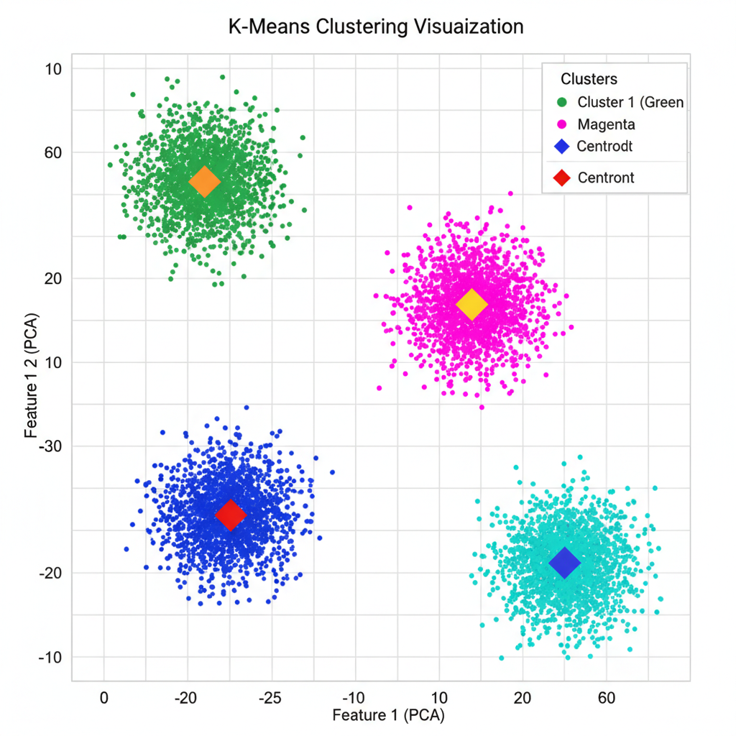
Types of ML
2: Based on training labels
Unsupervised
(No Labels)
(No Label)
Amount of label
Labeled)

Slide 9
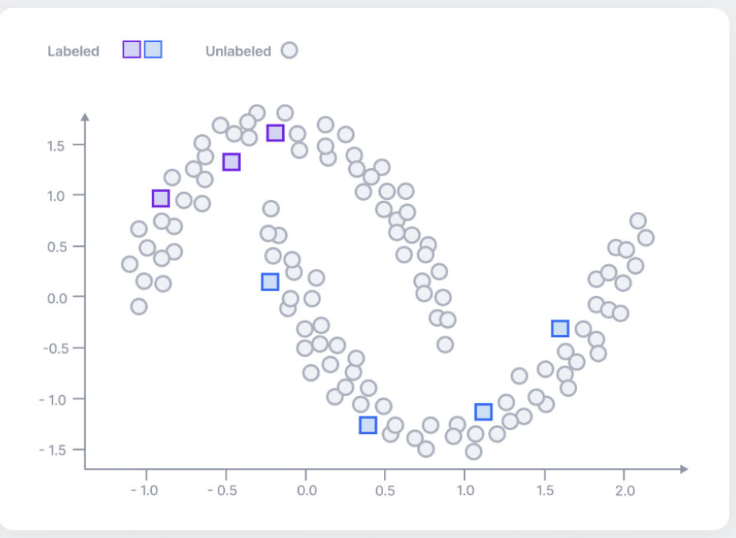
Types of ML
2: Based on training labels
Semi-supervised
(Labeled + unlabeled)
(No Label)
Amount of label
Labeled)

Slide 10
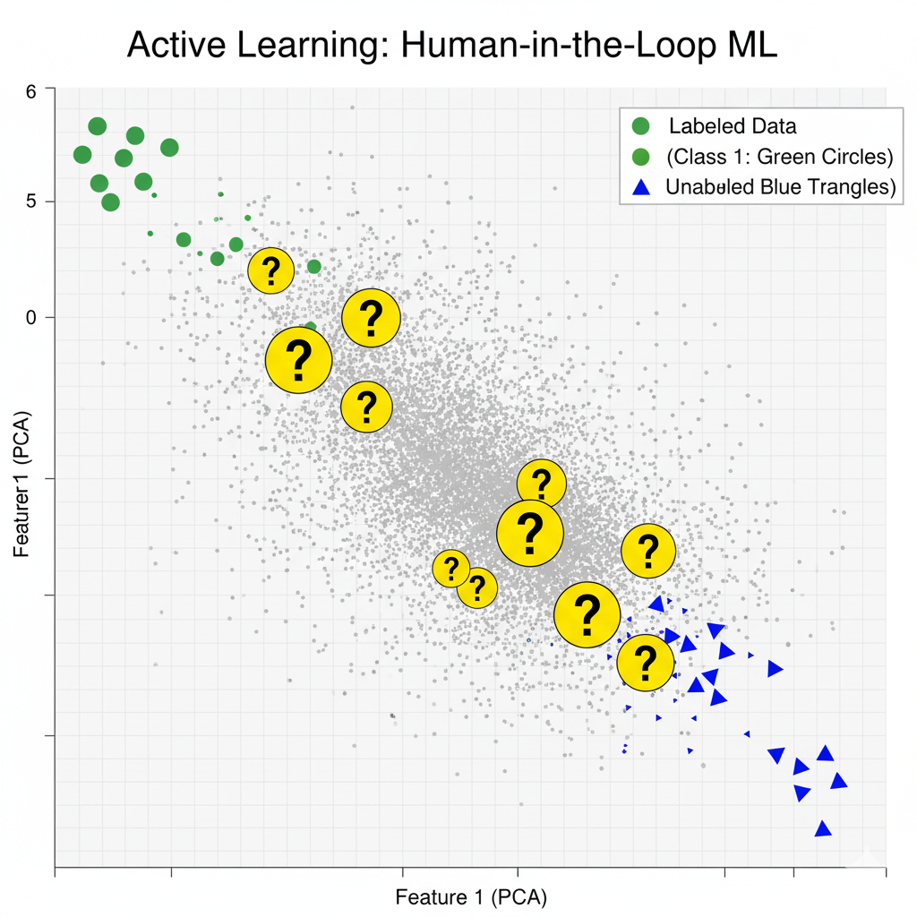
Types of ML
2: Based on training labels
Active learning
(gets labels iteratively)
(No Label)
Amount of label
Labeled)

Slide 11
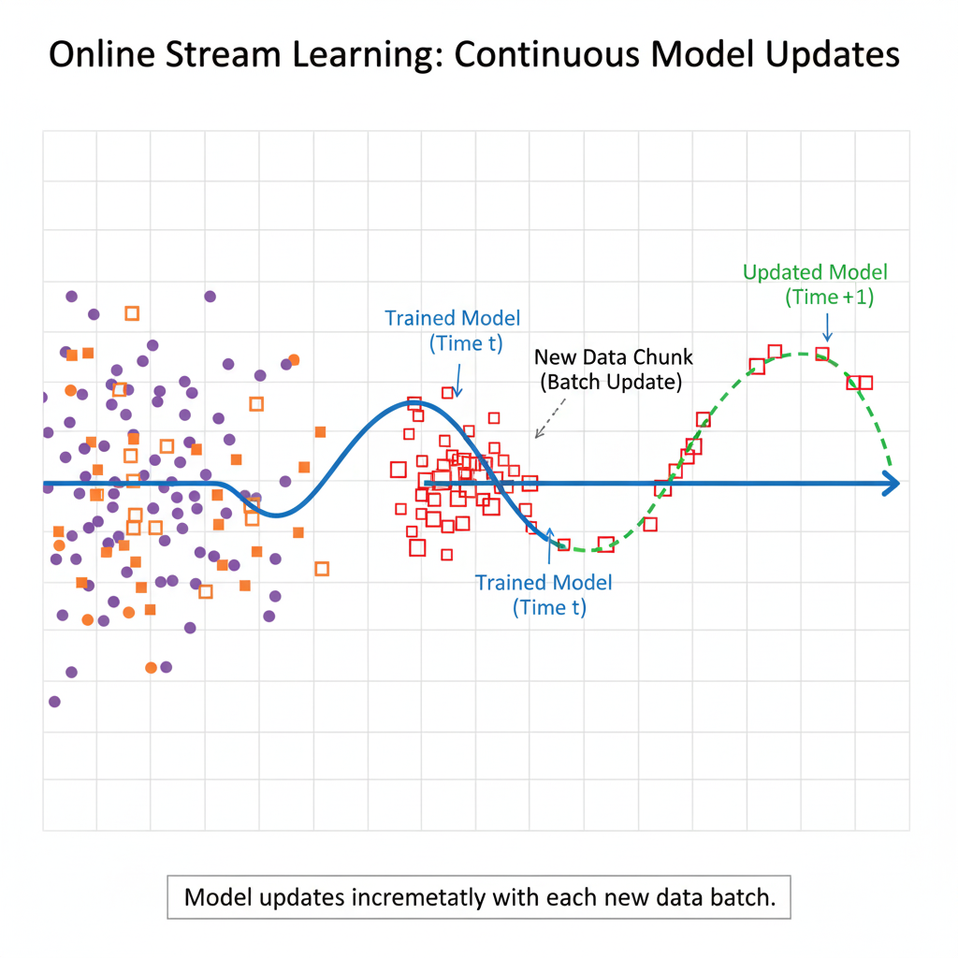
Types of ML
2: Based on training labels
Imagine learning to drive a car:
Batch Learning
You take one long driving course, finish it, and never practice again.
Your driving skills don’t improve after the course ends.
Online (Stream) Learning
You drive every day.
Each new experience (traffic, weather, mistakes) slightly improves how you drive.
You don’t restart driving school every time — you adjust continuously.
Online
(Stream)
(No Label)
Amount of label
Labeled)
Notes:
Another Real World Analogy: Instagram

Slide 12
Types of ML
Older data
The model was trained earlier (“Trained Model – Time t”).
2: Based on training labels
Online
(Stream)
(No Label)
Amount of label
Labeled)

Slide 13
Types of ML
2: Based on training labels
Older data
The model was trained earlier (“Trained Model – Time t”).
New data chunk arrives
Data comes in small batches or one point at a time (stream).
Online
(Stream)
(No Label)
Amount of label
Labeled)

Slide 14
Types of ML
2: Based on training labels
Older data
The model was trained earlier (“Trained Model – Time t”).
New data chunk arrives
Data comes in small batches or one point at a time (stream).
Model updates itself
Instead of retraining from scratch, it adjusts incrementally.
Online
(Stream)
(No Label)
Amount of label
Labeled)

Slide 15
Types of ML
Older data
The model was trained earlier (“Trained Model – Time t”).
New data chunk arrives
Data comes in small batches or one point at a time (stream).
Model updates itself
Instead of retraining from scratch, it adjusts incrementally.
Updated model (Time t+1)
The green dashed curve shows how the model changes after seeing new data.
2: Based on training labels
Online
(Stream)
(No Label)
Amount of label
Labeled)

Slide 16
Types of ML
2: Based on training labels
Examples:
Stock price prediction
Recommendation systems (Netflix, Amazon)
Fraud detection
Sensor and IoT data
Real-time user behavior tracking
Online
(Stream)
(No Label)
Amount of label
Labeled)

Slide 17
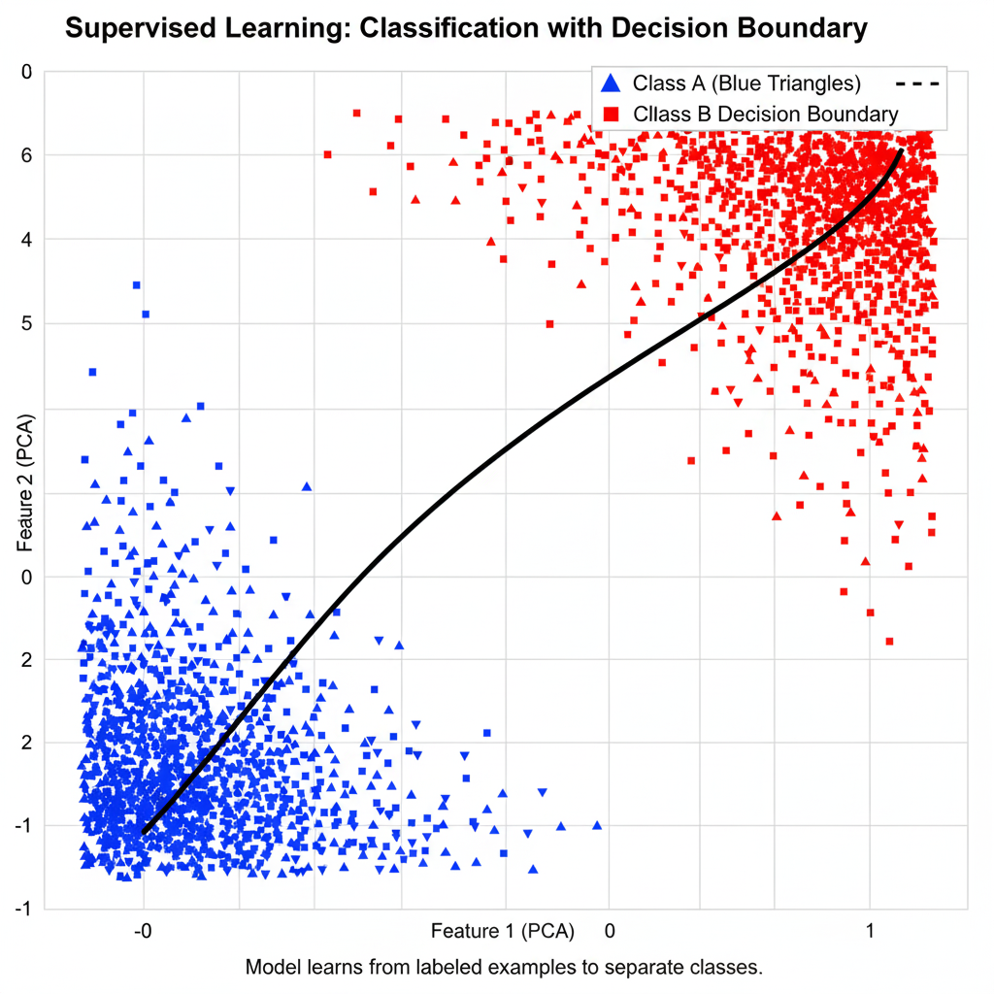
Types of ML
2: Based on training labels
Supervised
(Labeled)
(No Label)
Amount of label
Labeled)
Notes:
What PCA is Principal Component Analysis
PCA is a dimensionality reduction technique in machine learning.
It reduces many features (variables) into a smaller number while keeping most of the important information.
Think of it as compressing data without losing the main patterns.
Why we use PCA
Visualize high-dimensional data
Example: You have 100 features per student (grades, attendance, quizzes, etc.). PCA can reduce it to 2 or 3 features so you can plot it on a graph.
Remove redundancy / correlations
If some features are highly correlated, PCA combines them into a principal component.
Speed up ML models
Fewer features → faster computation → less noise.

Slide 18

International Journal of Information Technology, Research and Application (IJITRA) eISSN: 2583-5343
WWW.IJITRA.COM

